Slide 1
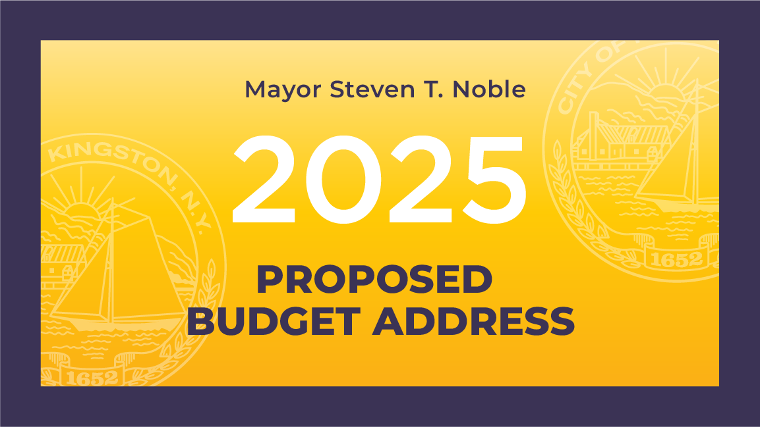

Slide 2
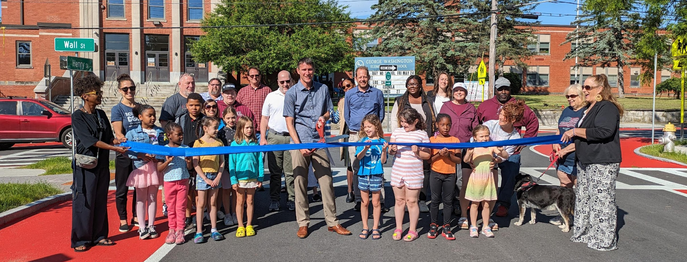
A LOOK BACK AT 2024

Slide 3
- Dietz Stadium renovation - Henry Street streetscape - Clinton Ave improvements - Post Office Park - 20 roads paved
MAJOR PROJECTS:

Slide 4
- Passed Housing Legislation - Acquired 25 Field Court - Prop. 200-unit development - 70-acres for parkland preservation - Business Park housing study
2024 Initiatives:

Slide 5
Fiscal Health is Strong

Slide 6
FISCAL STRESS SCORE
3.3%

Slide 7
Bond Rating at AA-/Stable

Slide 8
BUDGET OVERVIEW
- Zero Layoffs
- Low Fiscal Stress Score: 3.3%
- Investment in City staff
- Total Proposed Budget $59,846,212
- Tax Levy increase of 8.9%
- Tax Rates still below 2016 numbers

Slide 9
TAX RATES
Homestead
2016 2025
$10.16 $9.87

Slide 10
TAX RATES
Non-homestead
2016 2025
$18.31 $15.10

Slide 11
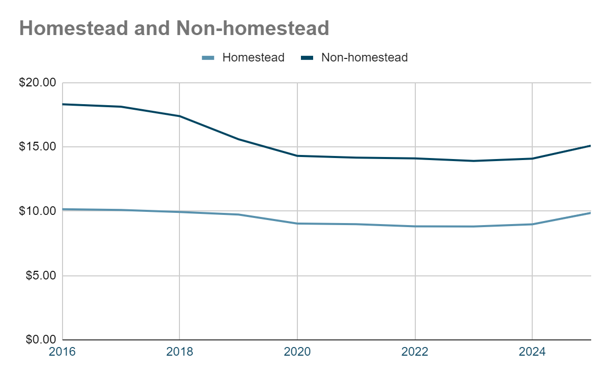

Slide 12
Tax Rates Declined for 7 Consecutive Years
City Tax Rates per $1,000
2016
2017
2018
H: $10.16
NH: $18.31
2019
H: $10.10
NH: $18.13
2020
2025
H: $9.94
NH: $17.39
2021
H: $9.74
NH: $15.59
2022
H: $9.04
NH: $14.30
2023
2024
H: $9.87
NH: $15.10
H: $8.99
NH: $14.17
H: $8.98
NH: $14.09
H: $8.82
NH: $14.11
H: $8.81
NH: $13.91
H = Homestead
NH = Non-Homestead
Notes:
**NEED SPACING TWEAKS

Slide 13
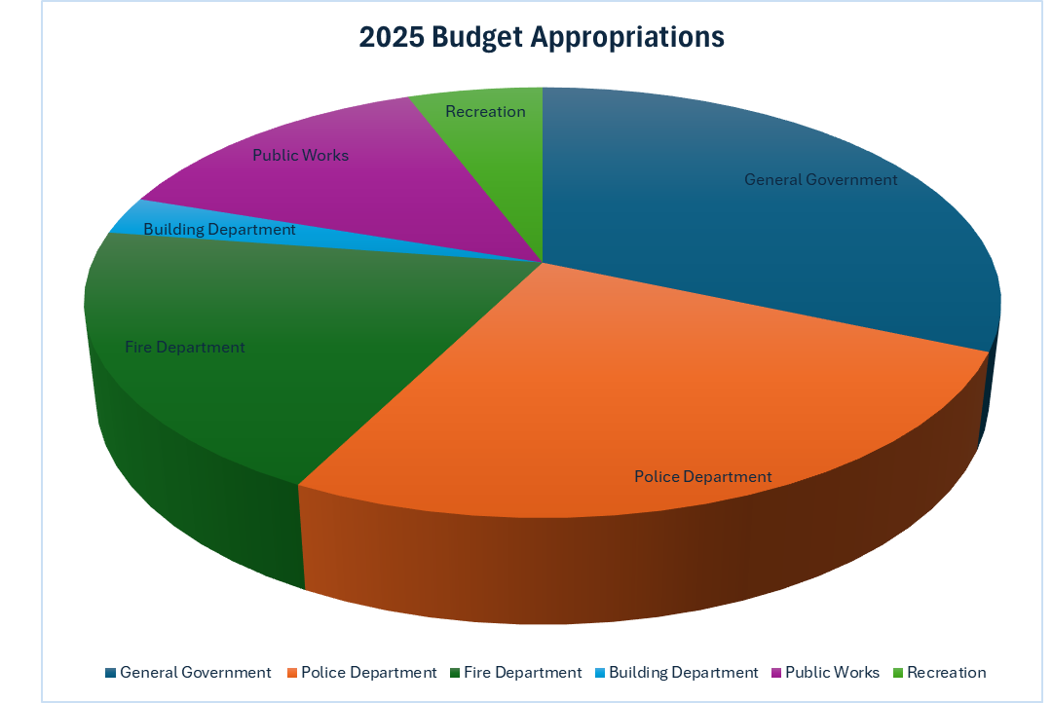

Slide 14
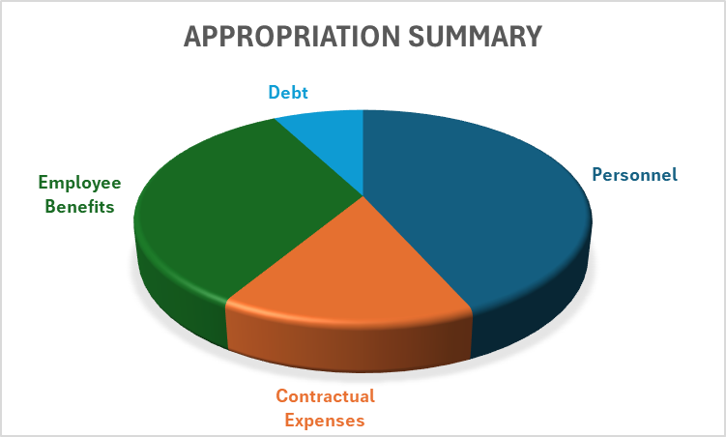

Slide 15
2025 Budget Drivers
Tax Levy Growth in 2025

Slide 16
PARAMEDIC SERVICE
Kingston Fire Department takes over City of Kingston’s

Slide 17
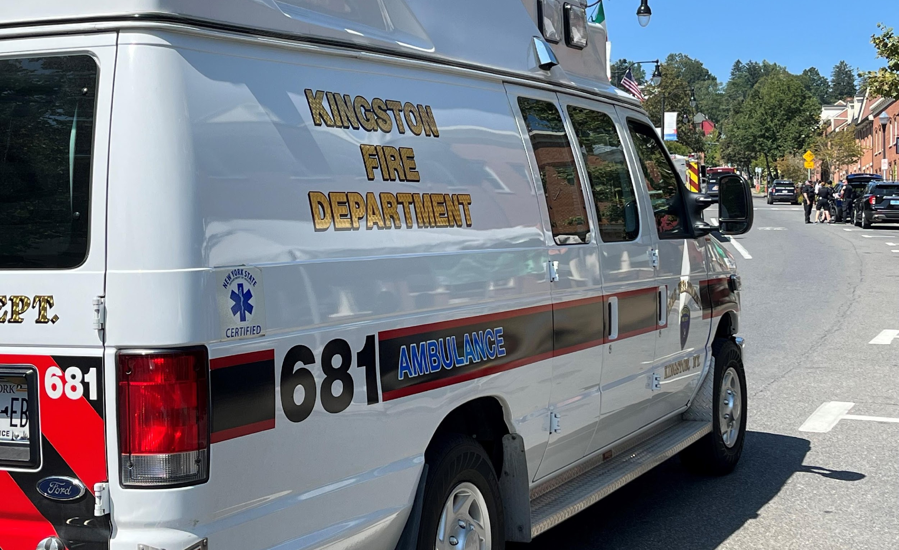
SINCE JANUARY 1, 2024:
- Over 4,000 calls for service answered
- Lives saved
- Mobile Mental Health diverted 175 from hospital care
Notes:
Asked Chief Rea for stats

Slide 18
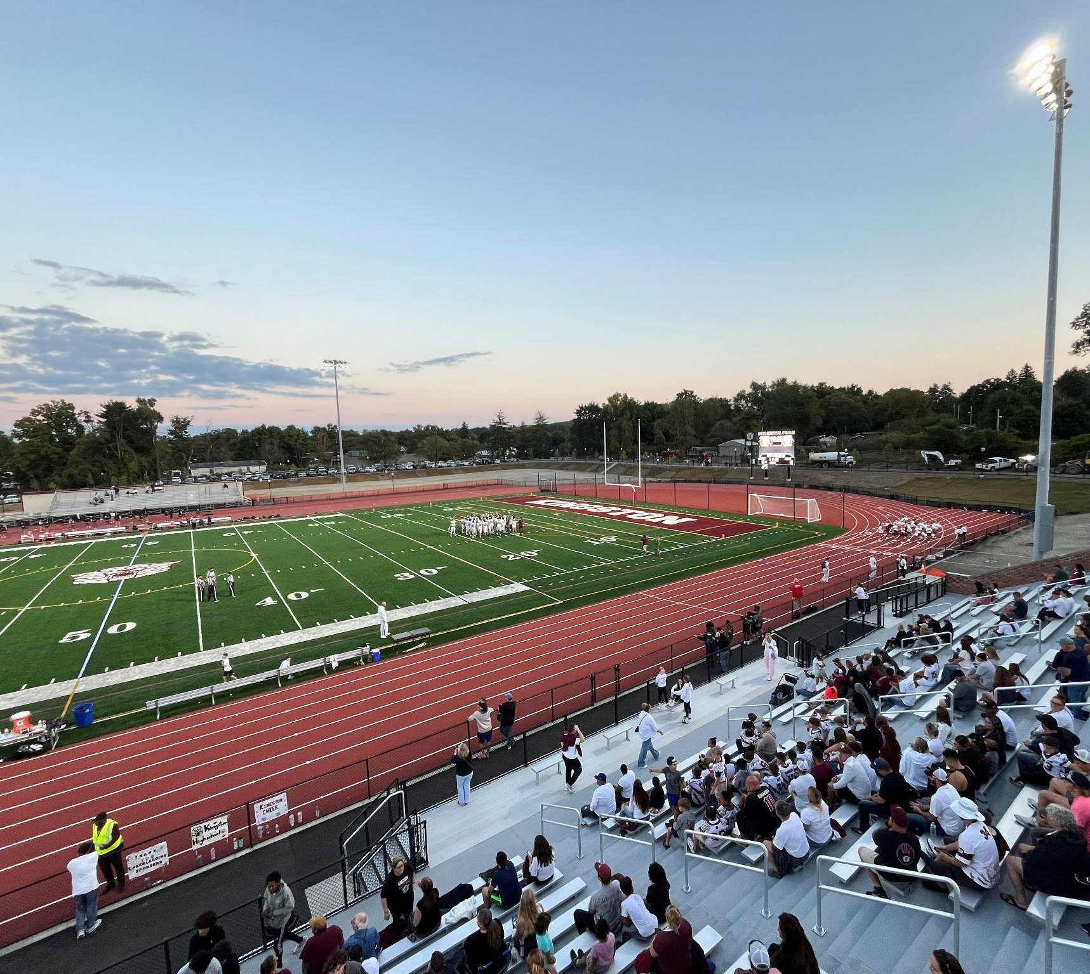
DIETZ STADIUM RENOVATION PROJECT Approx. $1M/year for 15 years
Know your material in advance
Anticipate common questions
Rehearse your responses
Stay calm
Actively listen
Pause and reflect
Maintain eye contact

Slide 19
City of Kingston
Liability/
Property Insurance Rate Increases

Slide 20
INVESTMENT IN
CITY STAFF

Slide 21
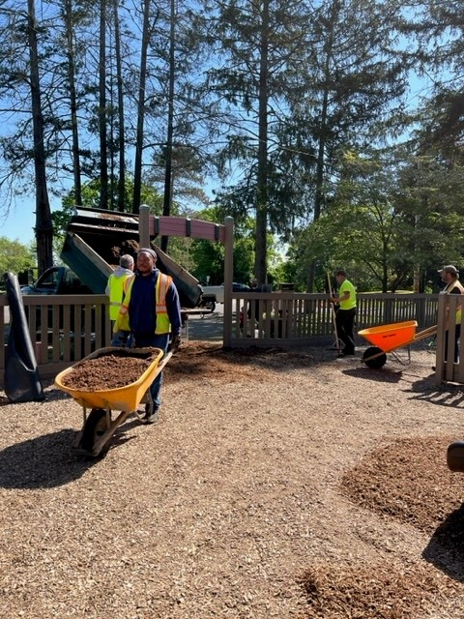
- Union contracts
- Pay increases
- Added 20+ positions over 10 years
- Retain quality workforce
- Zero layoffs

Slide 22
CITY OF KINGSTON STAFF/EMPLOYEE RAISES + BENEFIT INCREASES
Investing in staff = improved services

Slide 23
Equipment and Capital in 2025

Slide 24
Equipment
KPD patrol vehicles
Parks maintenance equipment
DPW Dump Trucks
WWTP equipment
KFD turnout gear
… and more

Slide 25
TRAFFIC CALMING EQUIPMENT

Slide 26
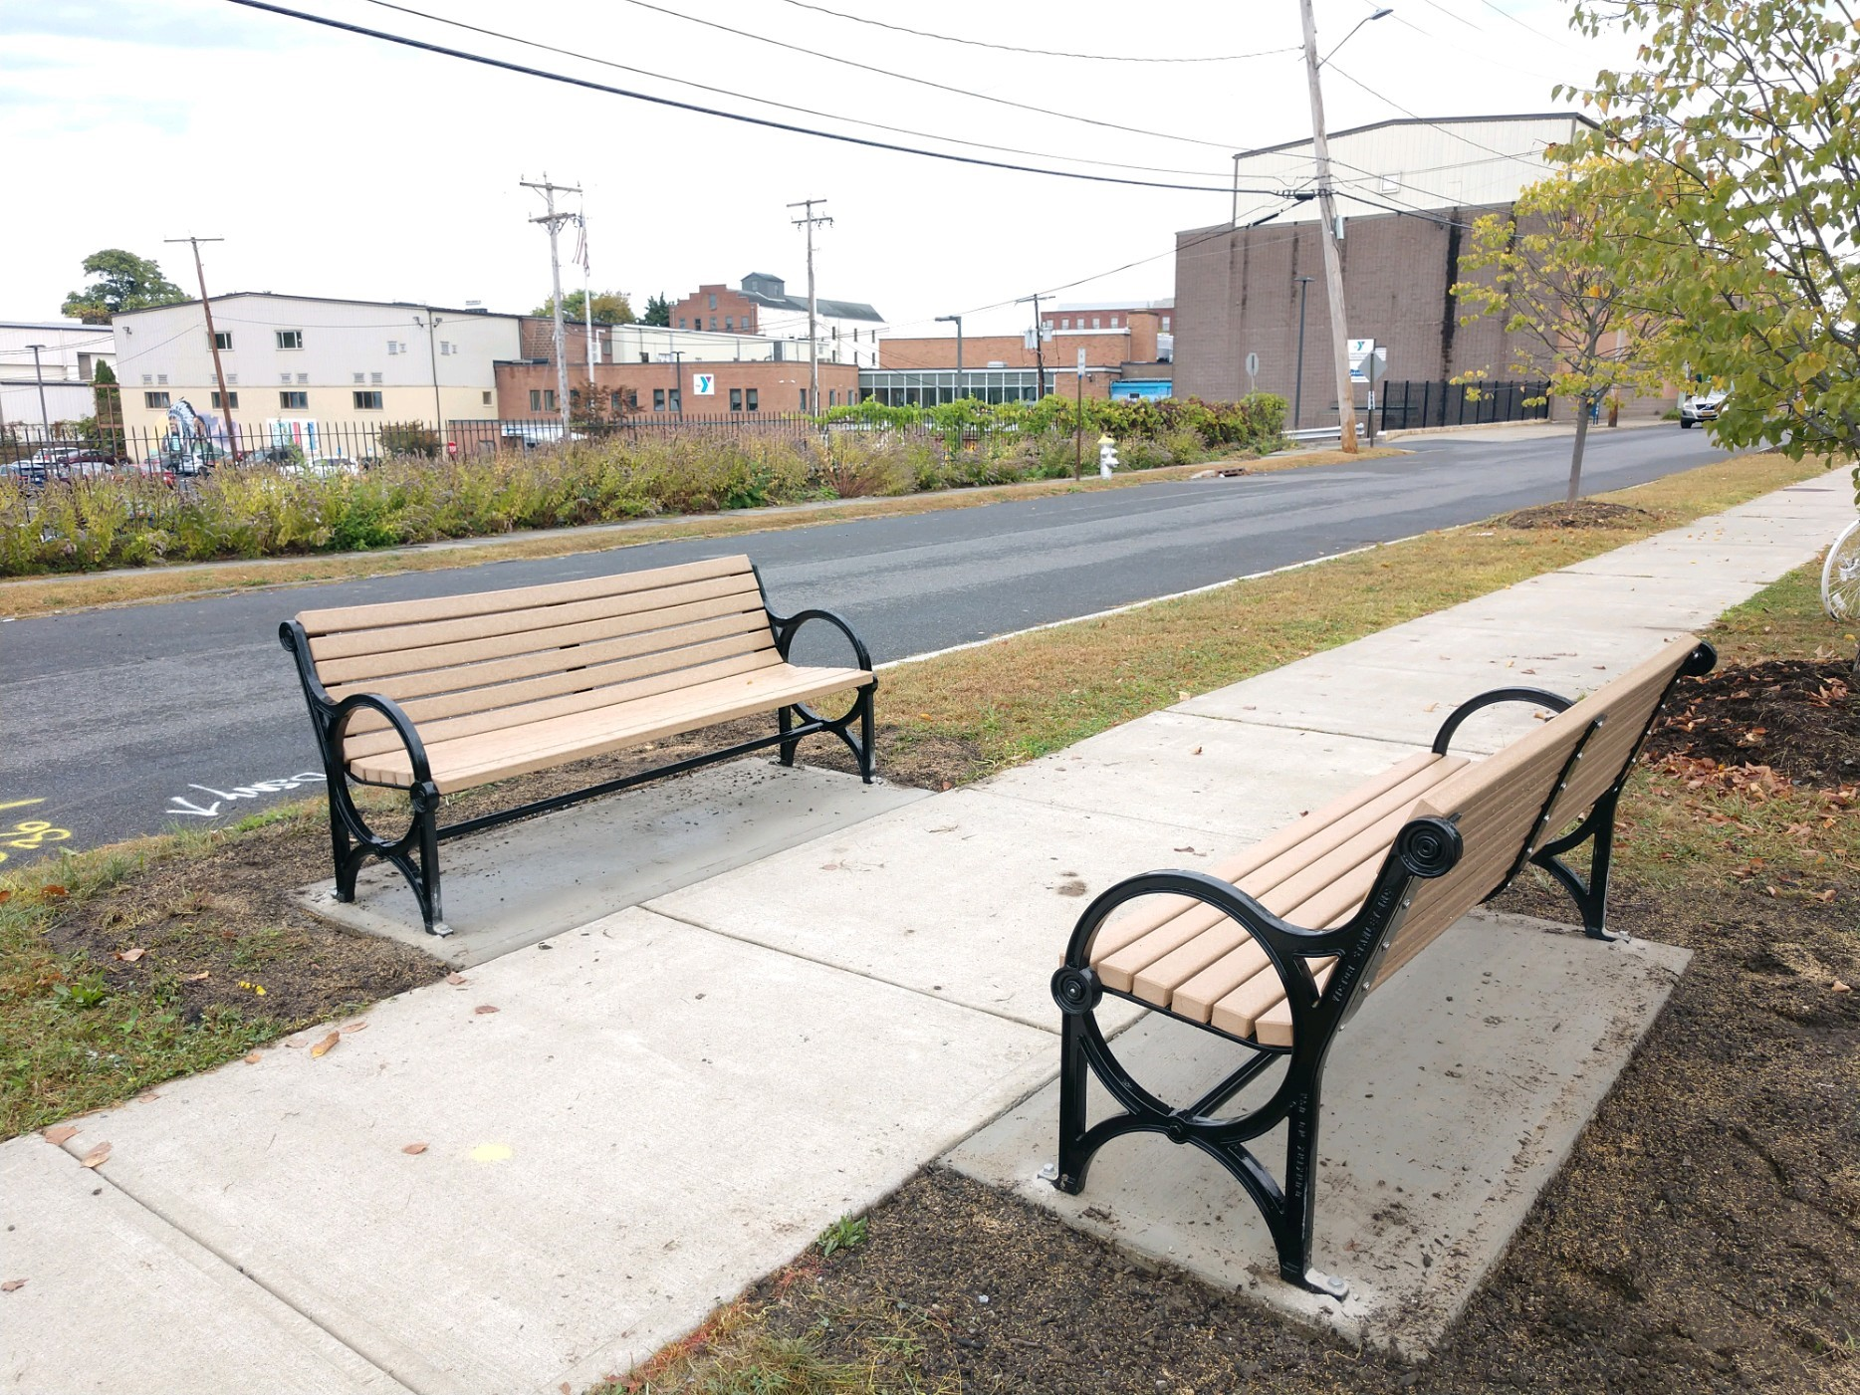
SIDEWALK IMPROVEMENT PLAN
Development

Slide 27
- Multiple sewer repairs - Major solar projects - Wayfinding signage city-wide
- Intersection Upgrades
- Shade tree planting
2025 Projects:

Slide 28
Kingston Point Park/Beach upgrades and Kayak Dock
Rondout Center Improvement
Housing/mixed-use project
Waterfront grants totaling $28.5 million
Downtown Revitalization

Slide 29
GRANTS PORTFOLIO
$91 MILLION

Slide 30
THANK YOU FOR JOINING!
Please visit www.kingston-ny.gov/budget2025

Slide 31
